Slide 1

Capstone Project-3
Sentiment Analysis : Predicting sentiment of COVID-19 tweets
By – Sachin Yallapurkar

Slide 2
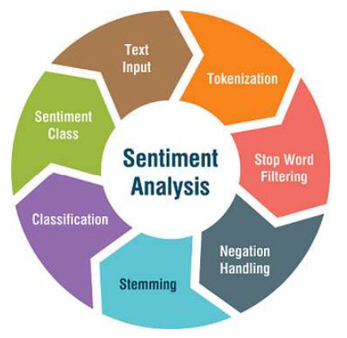
Problem Statement
Introduction & Data Summary
Exploratory Data Analysis
Text Preprocessing
Feature Engineering
Vectorization
Model Training
Evaluation
Challenges
Conclusion
Points for Discussion

Slide 3
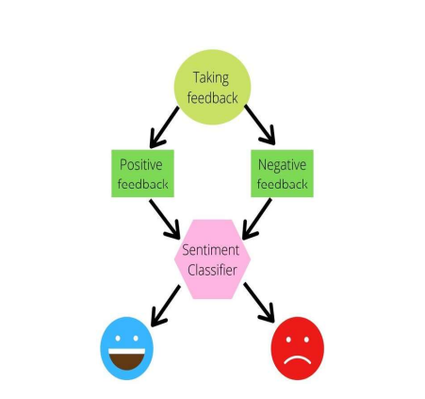
Problem Statement
The challenge is to build a CLASSIFICATION MODEL to predict the sentiment of COVID-19 tweets.The tweets have been pulled from Twitter and manual tagging has been done then.This is a supervised ml classification problem.

Slide 4
Introduction
● Sentiment Analysis is the process of computationally identifying and categorizing opinions expressed in a piece of text, especially in order to determine whether the writer's attitude towards a particular topic is positive, negative, or neutral.
● COVID-19 originally known as Coronavirus Disease of 2019, has been declared as a pandemic by World Health Organization (WHO) on 11th March 2020.
● The study analyzes various types of tweets gathered during the pandemic times hence can be useful in policy making to safeguard the countries by demystifying the pertinent facts and information.

Slide 5
Data Summary
● We were provided with Coronavirus_Tweets.csv dataset.
● Shape of the dataset is (41157,6).
● The Sentiment column is the dependent variable which consists of 5 different labels which are positive, negative, neutral, extremely positive and extremely negative.
We are given the following columns in our data:
1. Location - name of the location from which the tweet was shared.
2. TweetAt - time of the tweet at which the tweet was shared.
3. OriginalTweet - the original tweet shared by the user.
4. UserName - identification given by twitter to the user.
5. ScreenName - name projected on the screen of the user.
6. Sentiment - defined sentiment or label from the shared tweet.

Slide 6
EXPLORATORY DATA ANALYSIS

Slide 7
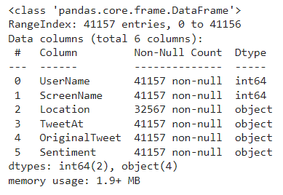
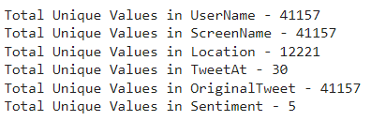
LOOKING FOR MISSING VALUES & UNIQUE VALUES
On looking at the dataset we can see that only ‘Location’ column shows the missing value.
So, to get rid-off from the missing values, we just left the feature as usual, as don’t know the exact location from where the tweets has been done.
Also the dataset contain 5 - unique values in ‘Sentiment’, and 30- unique dates of tweeting (indicating all tweets has been tweeted within the period of one month).

Slide 8
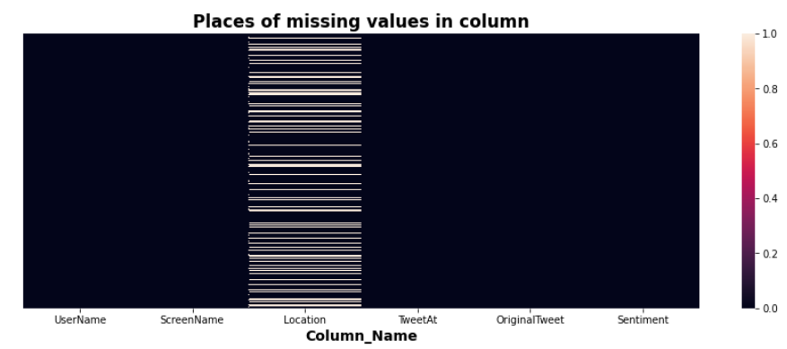
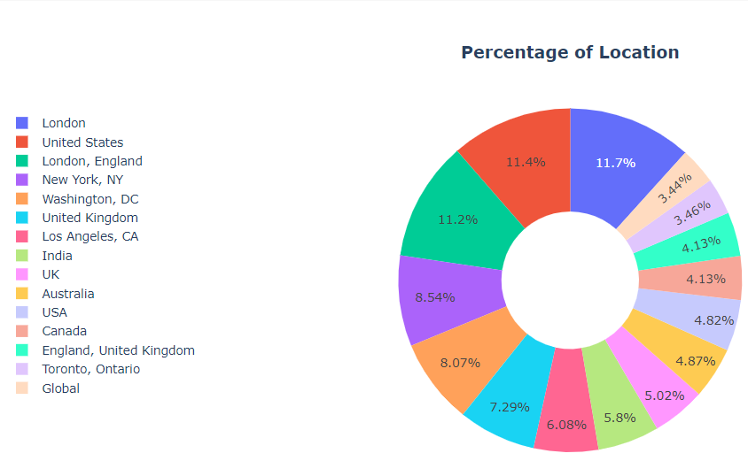
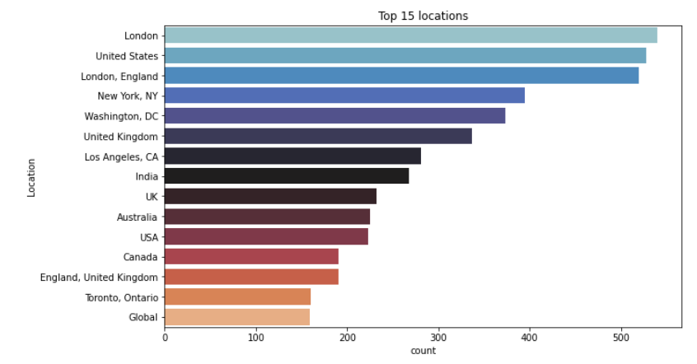
LOOKING INTO: ‘Location’ COLUMN
There are 20.87% (8567) of missing values or null values of various places in location column.
Most of the tweets has been tweeted from London (11.7% among top 15 locations).

Slide 9
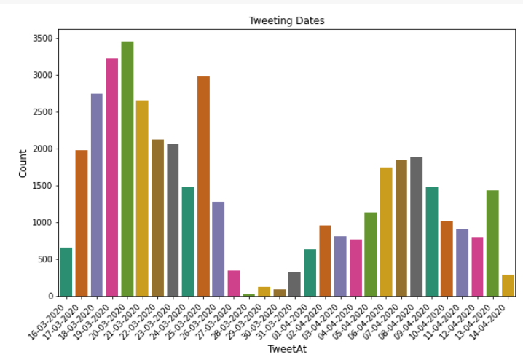
LOOKING INTO: ‘TweetAt’ COLUMN
Here we have created countplot for the looking into the different tweeting dates given in the dataset.
The tweeting date ranges from 16-03-2020 to 14-04-2020, which clearly corresponds to one month (30 days).
20-03-2020 shows the maximum tweeting date.

Slide 10
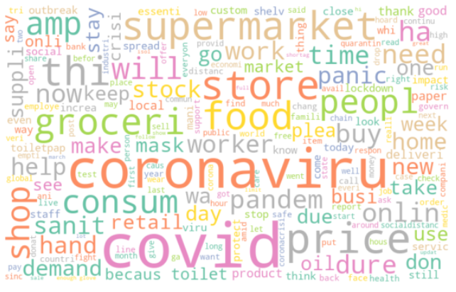
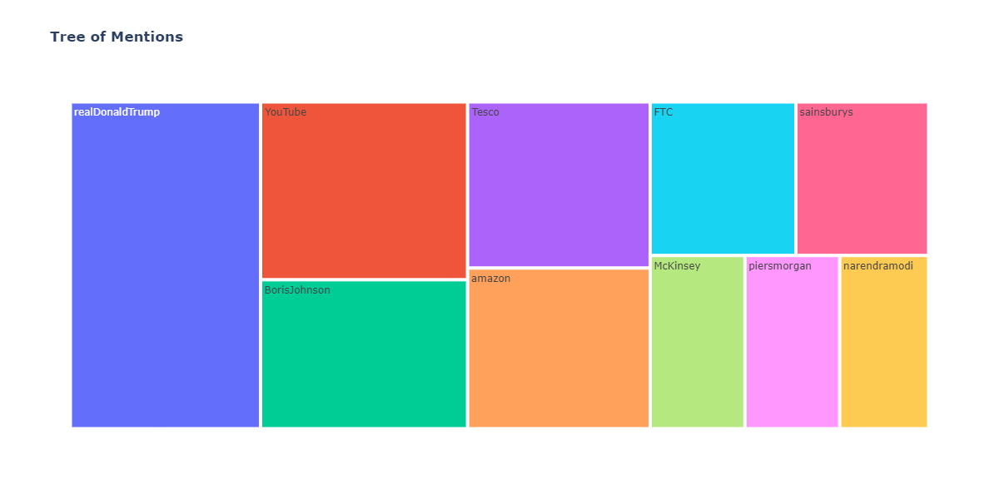
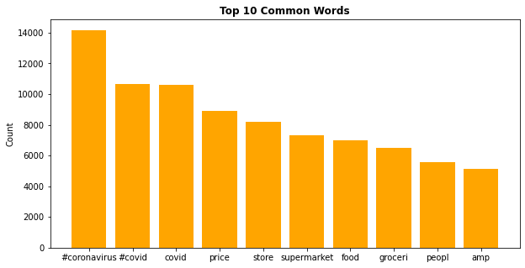
LOOKING INTO: ‘Original Tweet’ COLUMN
There are some words like coronavirus, covid has the maximum frequency in the dataset from word cloud.
realDonaldTrump, YouTube, Boris Johnson, etc were the top 10 trending mentions present in the tweets of the Original Tweet column.

Slide 11
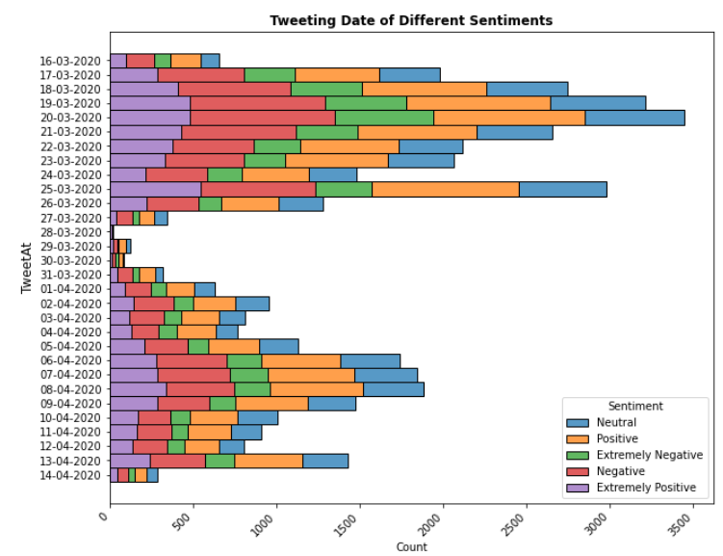
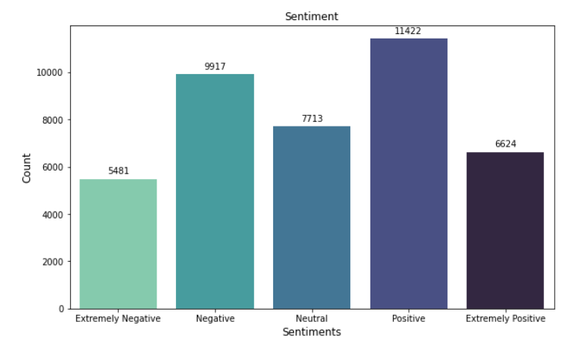
LOOKING INTO: ‘Sentiment’ COLUMN
The count plot of sentiments shows the Positive sentiment has the highest value while extremely negative has the lowest among all 5 sentiments values.
In relation to tweeting date, i.e. ‘TweetAt’ feature, the date of 20-03-2020 shows the highest number of tweets as well as the highest number of negative, extremely negative sentiment tweets.

Slide 12
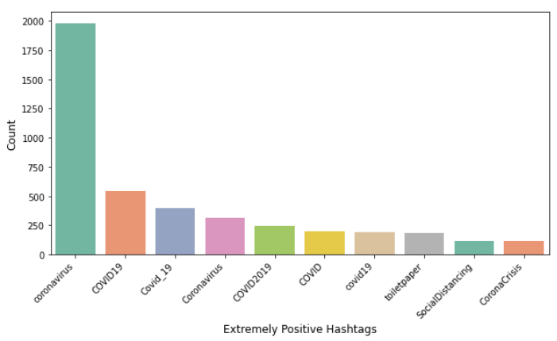
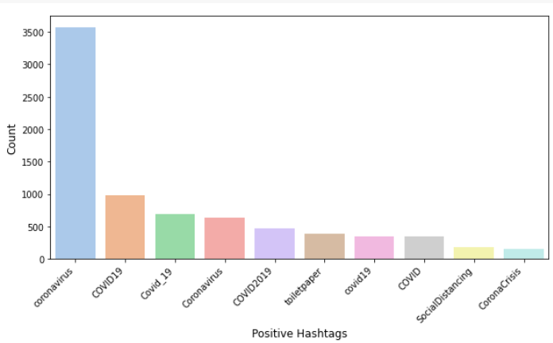
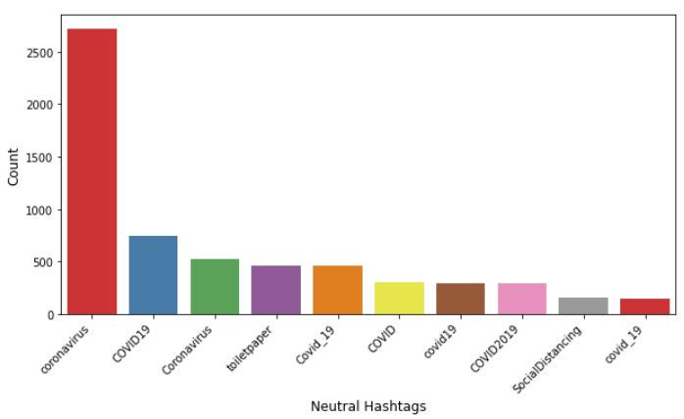
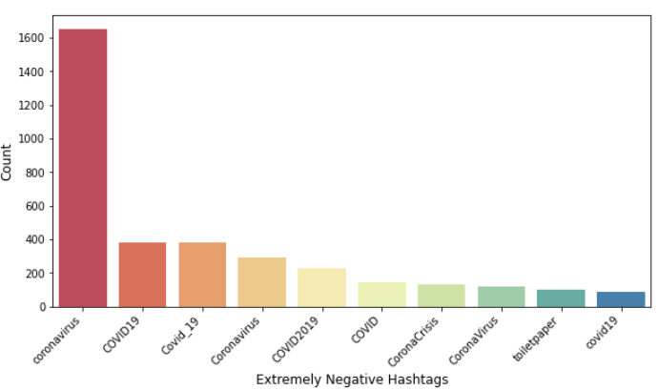
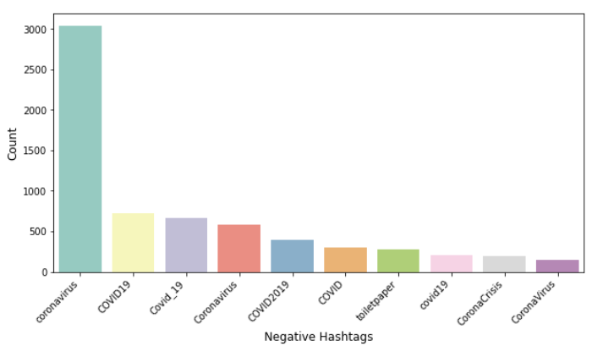
IMPACT OF HASHTAGS ‘#’ ON TWEETS SENTIMENT

Slide 13
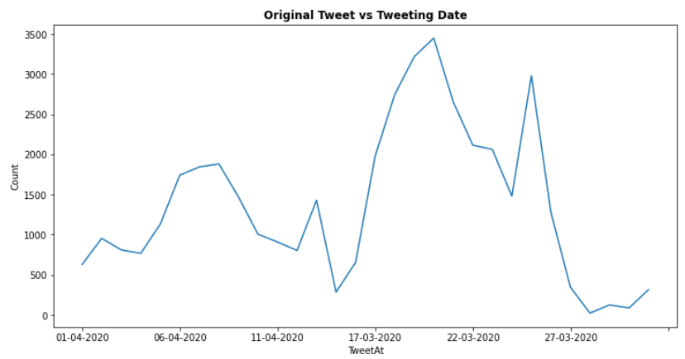
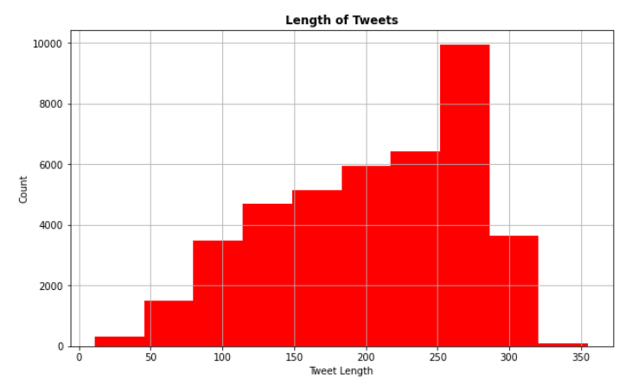
LOOKING INTO: ‘OriginalTweet’ COLUMN
When line plot is plotted between original tweet and tweeting date columns, it can been seen that the maximum number of tweets were between the dates of 17-03-2020 & 22-03-2020.
As well as a sudden drop can also been observed after 27-03-2020.
In another plot, where tweet string length has been calculated. It shows the range of text length running between 10 to above 350 characters, with having maximum length between 250 to 300.

Slide 14
TEXT PREPROCESSING
The text preprocessing of the text data is an essential step which makes raw text ready for mining.
The objective of this step is to clean noise which are less relevant to find the sentiment of tweets such as user handle, punctuations, special characters, numbers and terms which doesn’t carry much weightage in the context of the text.
The cleaning for the tweets is done over ‘OriginalTweet’ column.

Slide 15
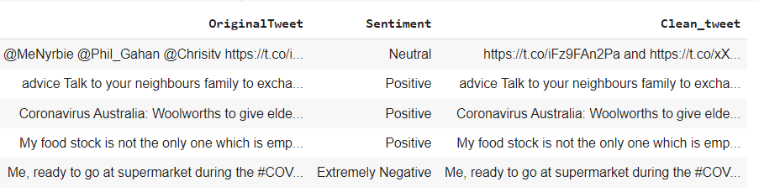
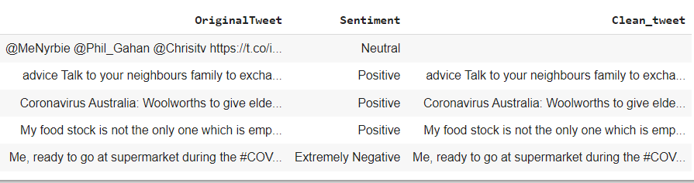
Removing Tweets Handle (@user), url, http
As we find lots of twitter handles (@user), different url with http links which are completely unnecessary for our further analysis.
Hence, we need to clean all these and proceed to next step of text preprocessing.

Slide 16
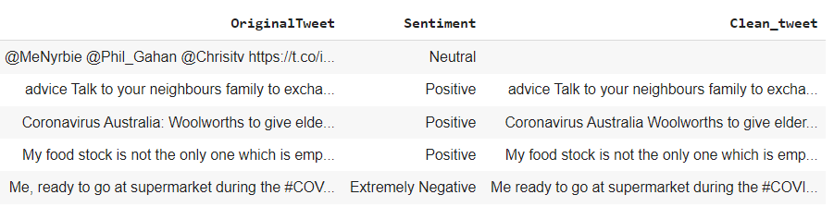
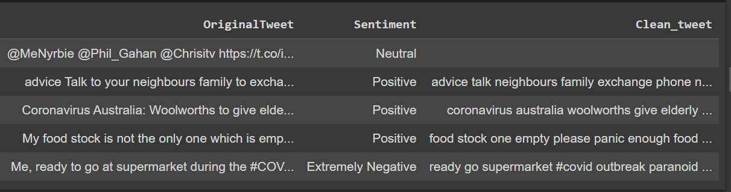
Removing Tweets Punctuations, Numbers & Special Characters
Removing Tweets Stopwords
In the next step we can see, the tweets also contain different punctuations, numbers and special characters, which are again cleaned.
In the next step we can see, the tweets contain different meaningless words which doesn’t give much importance to sentence, which are again removed.

Slide 17
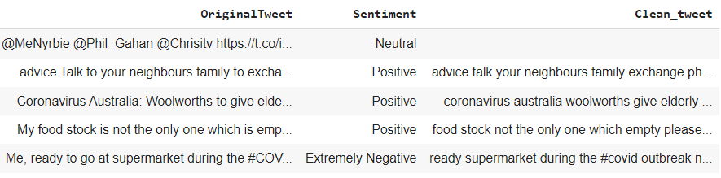
TOKENIZATION
In tokenization, we convert the group of sentences into tokens. It is also called text segmentation or lexial analysis. It basically split the data into small chunk of words.
Here tokenization has been performed via python NLTK library of tokenize().

Slide 18
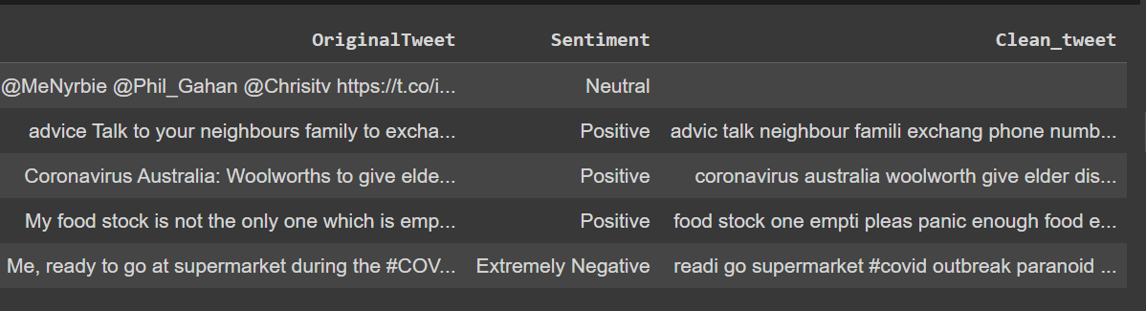
STEMMING
Stemming is the rule based process for stripping the suffixes (“ing”, “ly”, etc.) from a sentence.
It can be imported in python via NLTK library and here we have used SnowballStemmer and stemming is one of the important step of NLP.

Slide 19
FEATURE ENGINEERING

Slide 20


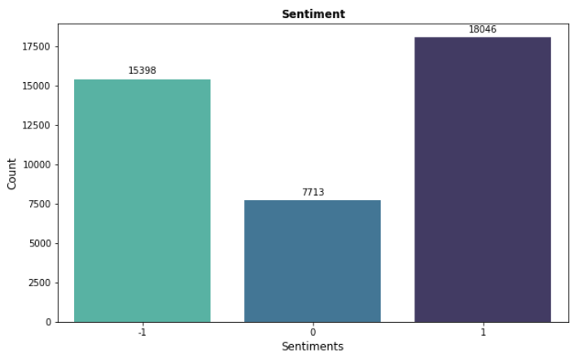
Encoding The Sentiment
There are 5 different sentiments are present in dataset. neutral , positive, extremely positive, negative & extremely negative.
To make problem simpler we encoded the sentiments into 3 different values where we merged Extremely positive and Positive into one and Extremely Negative and Negative into another.
Now we have Sentiments are – Positive: ‘1’, Neutral: ‘0’, Negative: ‘-1’

Slide 21
VECTORIZATION
In the next step, we choose CountVectorizer() as our vectorizer.
It will create a sparse matrix of all the words and the number of times they are present in the document.
By default, Countvectorizer converts the text to lowercase and uses word-level tokenization.
Here we have used CountVectorizer with <decode_error = 'replace',stop_words = stop>
CountVectorizer() can be imported in python via sklearn library.

Slide 22
MODEL TRAINING
Models used for Classification:
Multinomial Naive Bayes
Logistic Regression
Support Vector Machine Classifier
Random Forest Classifier
Stochastic Gradient Descent Classifier
CatBoost Classifier

Slide 23
Why Multinomial Naive Bayes ?
Why Logistic Regression ?
Good accuracy for classification if the feature independence condition holds.
Space and time effective.
Can handle high dimensional data pretty well.
A good baseline model.
Unlike Naive Bayes it makes no assumption about the feature independence.
Logistic Regression with L1 regularization is well known for feature reduction.
Fast to train.

Slide 24
Why Support Vector Machine ?
Why Random Forest Classifier?
It is well known to handle high dimensional data.
It allows misclassification as well with soft margins.
Random Forest takes random samples and features to make train the model.
Time taking, but Decision tree like model with less chance to overfit.

Slide 25
Why Stochastic Gradient Descent?
Why CatBoost Classifier?
It is neural network based.
It converges comparatively faster for large datasets.
It fits one sample at a time.
Computationally Fast.
CatBoost is a high-performance open source library for gradient boosting on decision trees.
Uses symmetric trees, which result in a Fast Inference.
It is good in handling sophisticated categorical features.

Slide 26
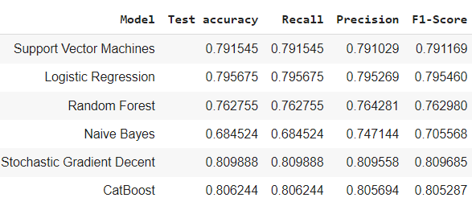
MODEL EVALUATION

Slide 27
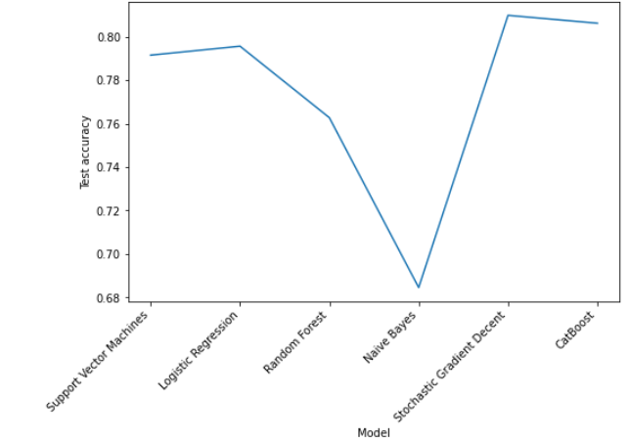
Model Test Accuracy
Overall the best test accuracy is for SGD Classifier with accuracy of 80.98%.

Slide 28
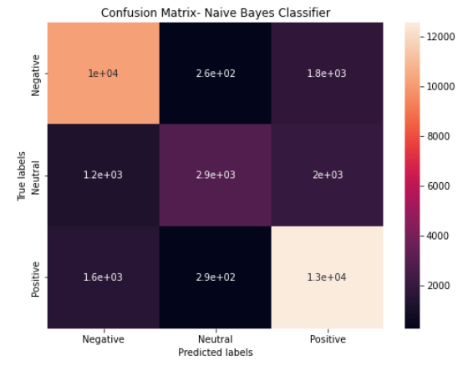
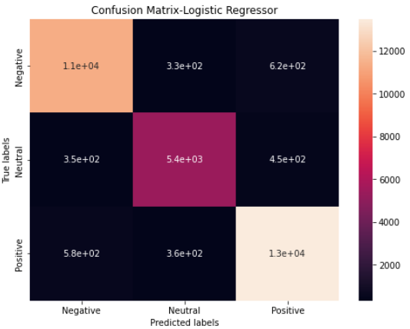
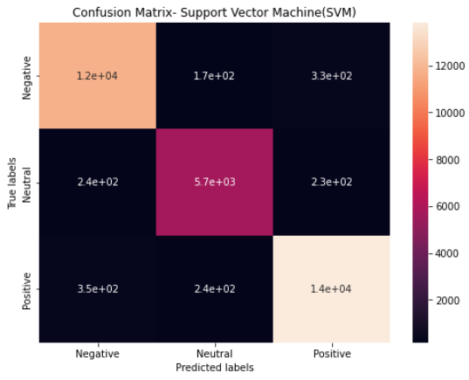
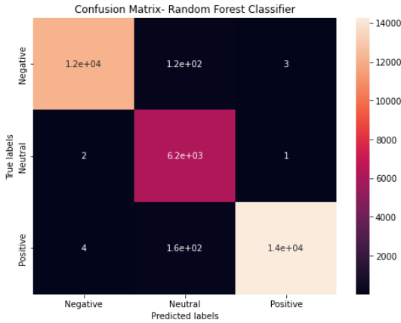
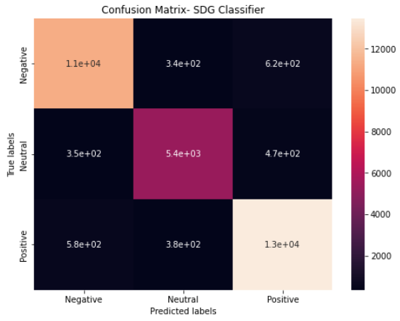
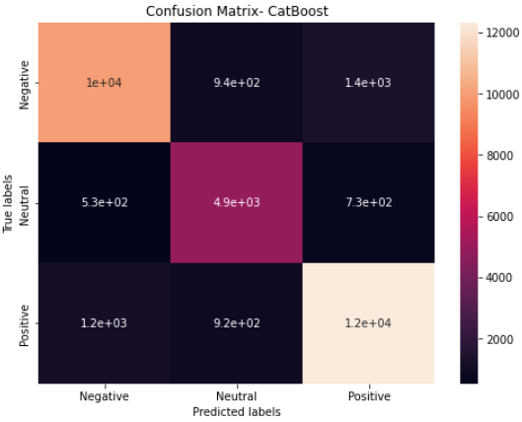
Confusion Matrix of all the models in order…

Slide 29
CHALLENGES
Locations being too many/unformatted/irrelevant
Sarcastic tweets
Computation time/crashes
Selection of best model
Cleaning of tweets

Slide 30
CONCLUIOSN
‘Location’ column contains approx. 20.87% of Null values.
The columns such as “UserName” and “ScreenName” does not give any meaningful insights for our analysis.
There are five types of sentiments- Extremely Negative, Negative, Neutral, Positive and Extremely Positive. So, we merged Extremely Positive with positive and Extremely Negative with Negative. And use encoding with value ‘-1’ for negative, ‘0’ for neutral and ‘1’ for positive.
All tweets data collected between months of March and April 2020 and of around 30 days.
Most of the tweets came from London followed by U.S.
Among top 10 mentions in tweets real Donald Trump was the top mentioned name and "#coronavirus" was the most trendiest hashtag.
After evaluation of different model, best test accuracy of 80.98% delivered by Stochastic Gradient Descent Classifier (SGD) for multi-class classification.

Slide 31


